Slide 1
Valuing Start-Up & Early Stage Companies…Art or Science
IACT Presentation
February 23, 2010
Frank Morse
Managing Director
Carter Morse & Mathias

Slide 2
Presentation Outline
Traditional Valuation Approaches
Early Stage Company Valuations-
Art or Science
Valuation by Stage
Valuations are Down
Introduction

Slide 3
CMM Profile
History | Founded 1987
Services | Sell-side advisory Buy-side advisory Valuation services | Arranging equity & mezzanine capital Senior debt financing Financial advisory services
Focus | Maximizing shareholder value
Track Record | 300+ clients
Clients | Closely-held middle market companies
Transaction Size | $10 million to $100 million
Industries | Healthcare CPG/Retail Aerospace Clean Tech |  | Specialty Manufacturing Software and IT Business services Financial services

Slide 4
Valuation: A Working Definition:
At the core of every investment transaction is a mutually accepted valuation of the company by the investor and entrepreneur.
A valuation reflects both the entrepreneur’s determination of the acceptable amount of ownership that may be given in return for the investor’s capital and expertise, and the venture investor’s determination of the risks and rewards of the investment.
Value equals the present value of future benefits of ownership
Adapted from Understanding Valuation:
A Venture Investor’s Perspective,
Callow and Larsen

Slide 5
Valuation Premises
Value equals the present value of future benefits of ownership
Value is not always a single number
Value is based on a single point in time
What is valued
  minority interests vs controlling interests
  equity value vs. entity value

Slide 6
Traditional Valuation Approaches
Income Approach
Asset Approach
Market Approach

Slide 7
Valuation Methodologies
Market Approach
Comparative Public Companies
  Price / Earnings
  Price / Cash Flow
  Price / Book Value
  Price / Revenues
  Price / Asset Value
Comparative Acquisitions

Slide 8
Valuation Methodologies
Income Approach
Income Methodology
  Capitalized Returns Approach
    Capitalization of Earnings
    Capitalization of Cash Flow
  Discounted Future Returns Approach
    Discounted Net Cash Flow
    Discounted Earnings

Slide 9
Valuation Methodologies
Asset Approach
    Net Asset Value
    Adjusted Book Value
    Liquidation Value

Slide 10
Private Equity Valuations
Transactions under $250 million
Source: GF Data Resources

Slide 11
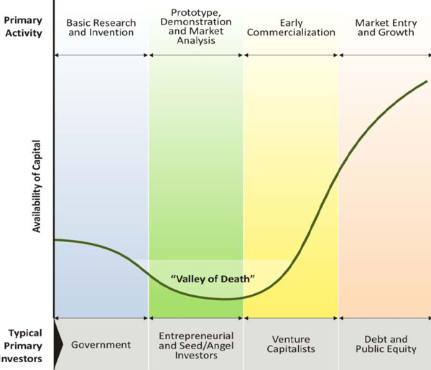
Valley of Death

Slide 12
Valuation stages-Art or Science
Seed
Series A
Series B
More of an impressionistic approach
More clarity on market validation, management, technology and business model
Pure Abstract Art
No mathematics or approaches have any validity at this stage
A little less artistic
Product/service has “market traction”, forecasts are reality based, technology risk mitigated , management is becoming “proven” and markets are well defined.
Valuation begins to lend itself to Market and Income Approaches.

Slide 13
Valuation stages-Art or Science
Series C
More of the same as Series B
Public
Valuation is now an organized market…supply & demand
Mezzanine
Milestones have been reached
All company needs is capital
Company has sustainable profitable operations
As much of a science as we have
Information is readily available to all potential shareholders.
Mezzanine capital relies on cash flow and credit markets

Slide 14
Valuation By Stage
Financing | Company Stage | Data | Risk Uncertainty | Value Range ($MM)
Seed | Incorporation & Early Development | Concept, soft data, no mgt, | Highest Risk | .1-1.0
Series A | Development | Market validation and little technology risk | Very High | 3-5
Series B | Shipping Product | Beginning Revenues | High | 5-10
Series C | Reference Clients | Predictive Revenues | Moderate | >10
Later Stage/Mezzanine | Profitable | Hard Data, EBITDA | Normal Business Risk | 20-50
Public Company | Profitable | Public Information | Least Risk | Whatever
Notes:
Important definitions:
Enterprise Value = Equity Value + Total Debt
Subordinated Debt includes 2nd lien loans and unsecured debt
Equity includes invested capital, seller rollover equity and seller financing

